Slide 1
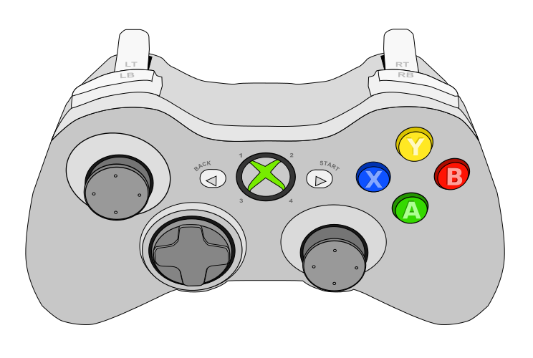
Controller 1
Drive Forward
Strafe Left
Strafe Right
Drive Back
Turn Left
Turn Right

Slide 2
Controller 2
Spit Boxes Out
Suck Boxes In
Spin Boxes
Lower Box Collector
Raise Box Collector
Lower Robot
At Same Time
Raise Robot
Toggle Arms In/Out

Slide 3
Controller 1 for Both
Spit Boxes Out
Suck Boxes In
Spin Boxes
Lower Box Collector
Raise Box Collector
Drive Forward
Lower Robot
At Same Time
Raise Robot
Strafe Left
Strafe Right
Drive Back
Toggle Arms In/Out
Turn Left
Turn Right

